Slide 1

Economic Geography: An Overview
DR RANJITA ROY SARKAR, ASSISTANT PROFESSOR, KGTM

Slide 2



Economic Geography: An Overview
This presentation explores the intricate relationship between economic activities and geographical factors. We will delve into the concepts of economic activity, the influences on location, and the significance of primary, secondary, and tertiary sectors, particularly in the context of India. By examining theories such as Von Thunen and Weber, alongside real-world examples, we aim to provide a comprehensive understanding of economic geography's role in shaping regional development and trade dynamics.

Slide 3






Introduction to Economic Geography
Spatial Aspects of Economy
Factors Influencing Location
Economic geography examines how economic activities are distributed across space, influencing regional development and resource allocation in various sectors.
Key factors such as natural resources, labor availability, and market access significantly affect the location of economic activities, shaping regional economies.
Importance of Economic Activity
Understanding economic activities is crucial for analyzing regional development, as it helps identify growth opportunities and challenges in different areas.
Photo by Heeren Darji

Slide 4



Factors Affecting Location
Von Thunen's Theory
Weber's Industrial Location
Geographical Influences
Von Thunen's model illustrates agricultural land use based on distance from the market, emphasizing how transportation costs influence crop choice and land allocation.
Weber's theory highlights the significance of transportation and labor costs in determining industrial location, impacting regional economic development and resource allocation.
Both theories demonstrate how geographical factors shape economic activities, providing essential insights for regional planning and sustainable development strategies.

Slide 5


Primary Activities: Agriculture and Lumbering
Agriculture
Lumbering
Subsistence agriculture is practiced for local consumption, ensuring food security.
Lumbering contributes significantly to the economy, especially in forest-rich regions.
Commercial agriculture focuses on profit through large-scale production and exports.
Sustainable forestry practices are essential to balance economic benefits and environmental conservation.
Agricultural practices are influenced by factors such as climate, soil type, and market access.
The lumber industry supports local economies through job creation and resource management.

Slide 6
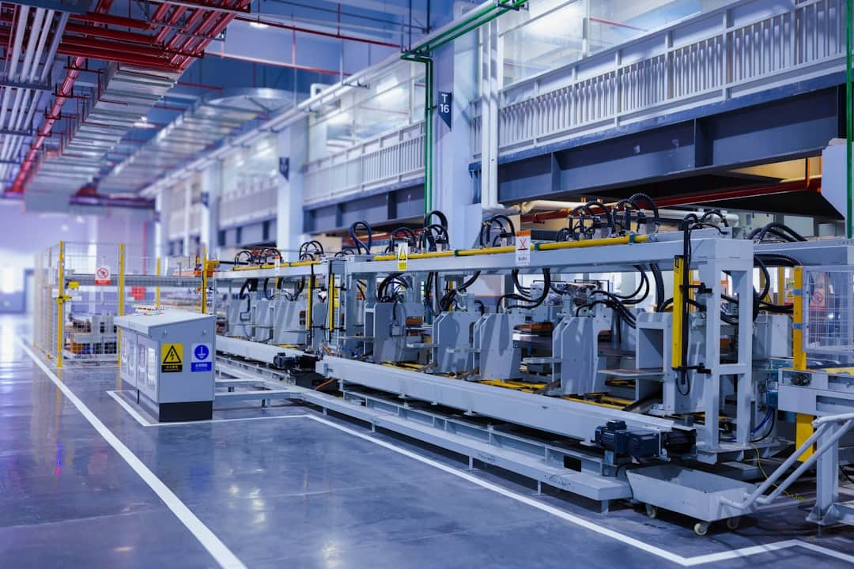



Manufacturing Industries in India
Aluminum Industry Overview
India's aluminum industry ranks among the top producers globally, contributing approximately 2% to the GDP and employing over 1 million people.
Tea Industry Significance
The tea industry is a cornerstone of India's traditional manufacturing, generating significant export revenue, with exports valued at around $800 million annually.
Role of SEZs
Special Economic Zones (SEZs) in India enhance industrial growth, attracting over $20 billion in foreign investment, fostering job creation and economic development.
Photo by Homa Appliances

Slide 7


Manufacturing Output Comparison: Aluminum vs. Tea

Slide 8




Tertiary Activities: Transport and Trade
Railways in India
Highways Development
Indian railways transport over 23 million passengers daily and 1.2 billion tons of freight annually, enhancing economic connectivity and efficiency across regions.
India's National Highways network spans over 150,000 km, connecting remote areas and facilitating trade, thus promoting regional economic development and accessibility.
WTO's Role
BRICS Trade Collaborations
The World Trade Organization regulates international trade, ensuring fair practices among member countries, which significantly impacts global trade dynamics and economic policies.
BRICS nations, comprising Brazil, Russia, India, China, and South Africa, enhance trade partnerships, influencing global economic trends and fostering mutual growth opportunities.

Slide 9


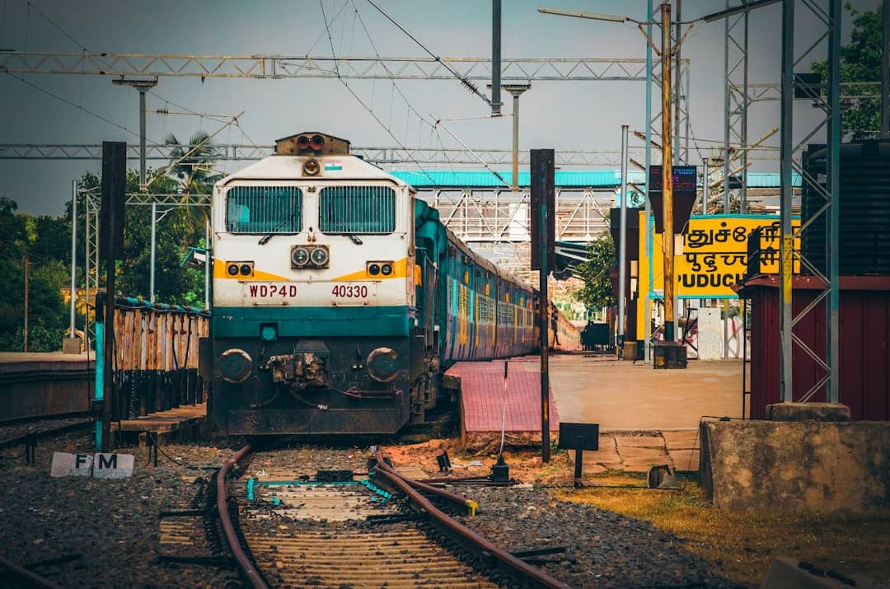

Visual Impact of Transport in India
This slide illustrates the extensive transport network in India, highlighting key railways and highways. The visual emphasizes the connectivity and economic growth driven by transport infrastructure, showcasing its role in facilitating trade and mobility.

Slide 10



Challenges in Economic Geography
Geographical Disparities
Environmental Concerns
Geographical disparities result in uneven economic development, with regions like Maharashtra thriving while others lag, highlighting the need for balanced growth strategies.
Industrial activities and agriculture contribute to environmental degradation, with India facing severe air and water pollution, necessitating sustainable practices to mitigate impacts.
Globalization Effects
Policy Frameworks
Globalization reshapes local economies, often leading to resource misallocation, as seen in rural areas losing agricultural viability to urban industrial demands.
Effective policy frameworks are essential to address these challenges, promoting sustainable growth while ensuring equitable resource distribution across regions.
Photo by Heeren Darji

Slide 11



“
Geography is the stage on which human history unfolds, shaping our economic activities and guiding us towards sustainable development through spatial understanding.
Dr. Ranjita Roy Sarkar, Assistant Professor, Dept of Geography, KGTM
This quote emphasizes the critical role of geography in understanding economic dynamics and planning for a sustainable future.

Slide 12
How to Achieve Sustainable Economic Geography
1
Promote Sustainable Agricultural Practices
Implement training programs for farmers on sustainable techniques, such as organic farming and crop rotation, to enhance productivity while preserving the environment.
2
Enhance Industrial Policies for Equitable Growth
Develop and enforce policies that encourage fair labor practices and environmental regulations in industries, ensuring that growth benefits all stakeholders.
3
Strengthen Transport Infrastructure for Connectivity
Invest in the development and maintenance of transport networks, including railways and highways, to improve access to markets and reduce transportation costs.
4
Foster International Collaborations for Trade
Engage in partnerships with international organizations and countries to promote trade agreements that support sustainable economic practices and equitable growth.

Slide 13




Key Takeaways
This presentation highlighted the intricate relationship between economic activities and geographical factors. Key takeaways include the significance of Von Thunen and Weber's theories in understanding location dynamics, the role of primary and secondary sectors in India's economy, and the impact of transport and international trade on growth. Moving forward, embracing sustainable practices in agriculture and industry will be crucial for economic resilience and environmental stewardship.

