Slide 1

Applications of Spatial Information Technology
DR RANJITA ROY SARKAR
ASSISTANT PROFESSOR, DEPARTMENT OF GEOGRAPHY, KGTM

Slide 2






Applications of Spatial Information Technology
Spatial Information Technology (SIT) revolutionizes data analysis and decision-making across various sectors. This presentation explores its applications in urban planning, environmental monitoring, and disaster management. By leveraging geographic information systems (GIS) and remote sensing, we can enhance efficiency and accuracy in spatial data utilization. Join us as we delve into the transformative impact of SIT on our world.

Slide 3








Introduction to Spatial Information Technology
Core Technologies Defined
Analyzing Spatial Relationships
Spatial Information Technology includes GIS, GPS, and remote sensing for data analysis.
Utilizes data to identify and analyze spatial relationships and patterns effectively.
Applications in Urban Planning
Evolving Data Accuracy
Essential for urban planning, enhancing decision-making and resource allocation processes.
Advancements in technology improve data accuracy and accessibility for users.
Photo by CHUTTERSNAP

Slide 4




Applications in Urban Planning
GIS Visualizes Urban Growth
GIS technology visualizes urban expansion and infrastructure requirements effectively.
Effective Land-Use Planning
Spatial data supports informed zoning decisions and optimal land-use planning.
Enhancing Public Engagement
Interactive mapping tools foster community involvement in urban development projects.
Photo by Leandro Barreto

Slide 5


Application of Spatial Information Technology in Environmental Monitoring
Remote Sensing Applications
GPS and Wildlife Tracking
Identifies changes in land cover and land use over time.
Tracks wildlife movements to understand habitat use and migration patterns.
Monitors vegetation health and biomass through satellite imagery.
Monitors changes in animal populations and their responses to environmental changes.
Detects environmental changes such as deforestation and urbanization.
Supports conservation efforts by identifying critical habitats.
Provides data for assessing natural disasters and their impacts.
Facilitates research on the effects of climate change on wildlife.

Slide 6


Growth of Spatial Information Technology

Slide 7


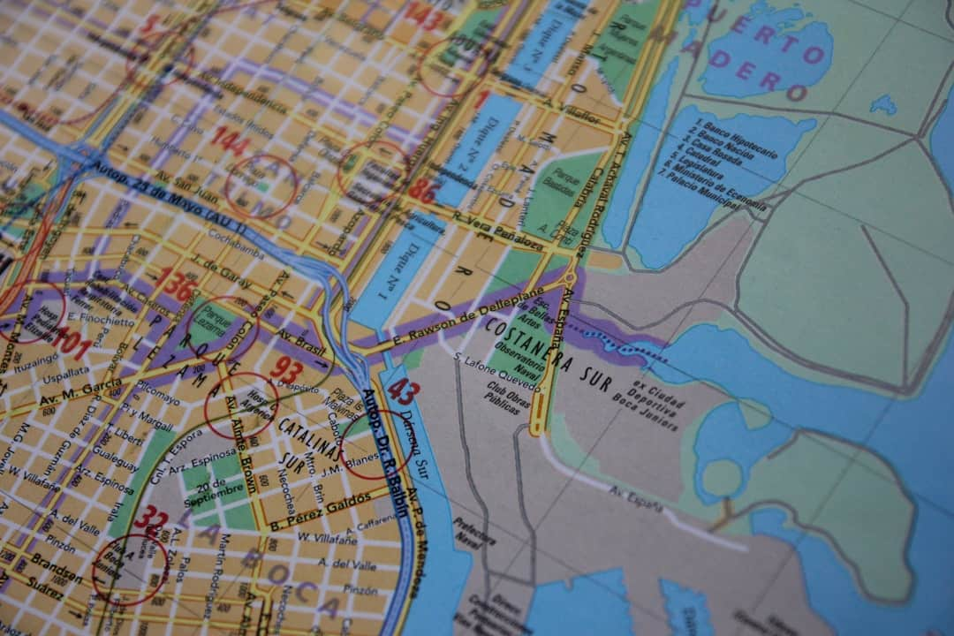

Impact of Spatial Technology
This visual illustrates how spatial information technology enhances decision-making in urban planning and disaster management.

Slide 8


Traditional vs. Modern Techniques in Spatial Analysis
Traditional Techniques
Modern Techniques
Rely heavily on manual data collection and field surveys.
Leverage automation and big data for efficient data collection.
Data processing is time-consuming and labor-intensive.
Utilize advanced algorithms for rapid data processing and analysis.
Limited integration of diverse data sources, often siloed.
Integrate various data sources (satellite, IoT, etc.) for comprehensive insights.
Analysis is often retrospective, lacking real-time insights.
Enable real-time data analysis for timely decision-making.
Requires specialized skills for data interpretation and mapping.
User-friendly interfaces allow broader access to spatial analysis tools.

Slide 9
How to Successfully Integrate Spatial Technologies
1
Assess Organizational Needs and Goals
Conduct a thorough analysis of your organization's objectives and requirements to identify how spatial information technology can enhance operations and decision-making.
2
Select Appropriate Technology and Tools
Research and choose the most suitable spatial technologies and tools that align with your organizational needs, ensuring they are user-friendly and scalable.
3
Train Staff on Spatial Analysis Techniques
Implement training programs for staff to develop their skills in spatial analysis, ensuring they are proficient in using the selected technologies effectively.
4
Evaluate and Refine Processes Continuously
Establish a system for ongoing evaluation of the spatial technology integration, allowing for adjustments and improvements based on feedback and performance metrics.

Slide 10
Frequently Asked Questions
?
What is GIS and how is it used?
GIS, or Geographic Information Systems, is a technology that captures, analyzes, and presents spatial or geographic data. It is used in various fields such as urban planning, environmental management, and transportation to make informed decisions.
?
How does spatial technology benefit businesses?
Spatial technology helps businesses optimize operations, improve customer targeting, and enhance decision-making by providing insights through location-based data analysis.
?
What are the challenges of implementing these systems?
Challenges include high initial costs, data quality issues, and the need for integration with existing systems, which can complicate the implementation process.
?
Is training necessary for effective usage?
Yes, training is essential to ensure users can effectively utilize GIS tools and interpret spatial data accurately, maximizing the technology's benefits.

Slide 11



Transformative Impact of Spatial Information Technology
90%
30%
Global Data with Spatial Component
Operational Cost Savings
Over 90% of the world's data is tied to a location.
GIS technology can reduce costs by up to 30% for organizations.
80%
50%
Earth's Surface Analyzed
Improved Decision-Making Speed
Remote sensing technologies analyze over 80% of the Earth's surface.
Spatial analysis enhances decision-making speed by 50%.

Slide 12


Future Trends in Spatial Information Technology
AI Integration in GIS
Real-Time Data Analytics
AI and machine learning will enhance GIS capabilities, improving data accuracy and insights.
Real-time analytics will enable faster decision-making in urban planning and disaster response.
Open-Source GIS Expansion
The rise of open-source tools will democratize access to spatial information technology.
Photo by Steve A Johnson

Slide 13



Key Takeaways
The application of spatial information technology enhances decision-making, improves resource management, and fosters sustainable development. Key outcomes include increased efficiency in urban planning, better disaster response strategies, and enhanced environmental monitoring. Moving forward, stakeholders must prioritize collaboration and invest in training to fully leverage these technologies for societal benefit.

