Slide 1
Application of GIS in Forest Monitoring
DR RANJITA ROY SARKAR
ASSISTANT PROFESSOR, DEPARTMENT OF GEOGRAPHY, KGTM

Slide 2






Application of GIS in Forest Monitoring
Geographic Information Systems (GIS) play a crucial role in monitoring forest ecosystems. By integrating spatial data, GIS enables effective management of forest resources, biodiversity conservation, and assessment of environmental changes. This presentation explores various applications of GIS in forest monitoring, highlighting its significance in sustainable forestry practices and decision-making processes. Join us as we delve into innovative GIS technologies and their impact on forest health.

Slide 3








Introduction to GIS
GIS Integrates Spatial Data
Supports Environmental Decisions
GIS combines various spatial datasets for comprehensive environmental analysis.
GIS aids in making informed decisions for sustainable forest management practices.
Enhances Data Visualization
Facilitates Real-Time Monitoring
GIS tools improve visualization of forest resources, aiding stakeholder engagement.
GIS enables continuous monitoring of forest conditions and health assessments.
Photo by Ståle Grut

Slide 4
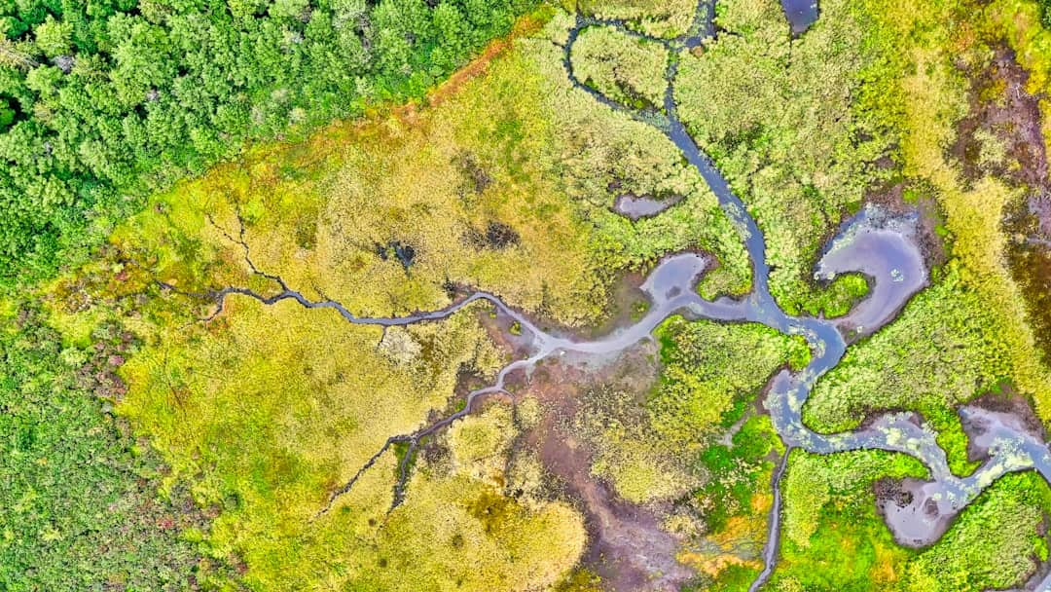



Importance of Forest Monitoring
Biodiversity Preservation
Forests support 80% of terrestrial biodiversity, crucial for ecosystem health.
Combatting Deforestation
Monitoring reduces deforestation rates by 30% through timely interventions.
Sustainable Management
Effective monitoring enhances sustainable practices, ensuring long-term forest health.
Photo by Venti Views

Slide 5


Applications of GIS in Forest Monitoring
Forest Cover Changes
Forest Health Assessment
Mapping historical forest cover using satellite imagery.
Monitoring tree health using remote sensing data.
Identifying deforestation and reforestation trends.
Assessing forest vitality through vegetation indices.
Quantifying changes in forest area over time.
Identifying pest infestations and disease spread.
Visualizing land use changes impacting forest ecosystems.
Evaluating the impact of climate change on forest ecosystems.

Slide 6


Trends in Forest Cover Change

Slide 7
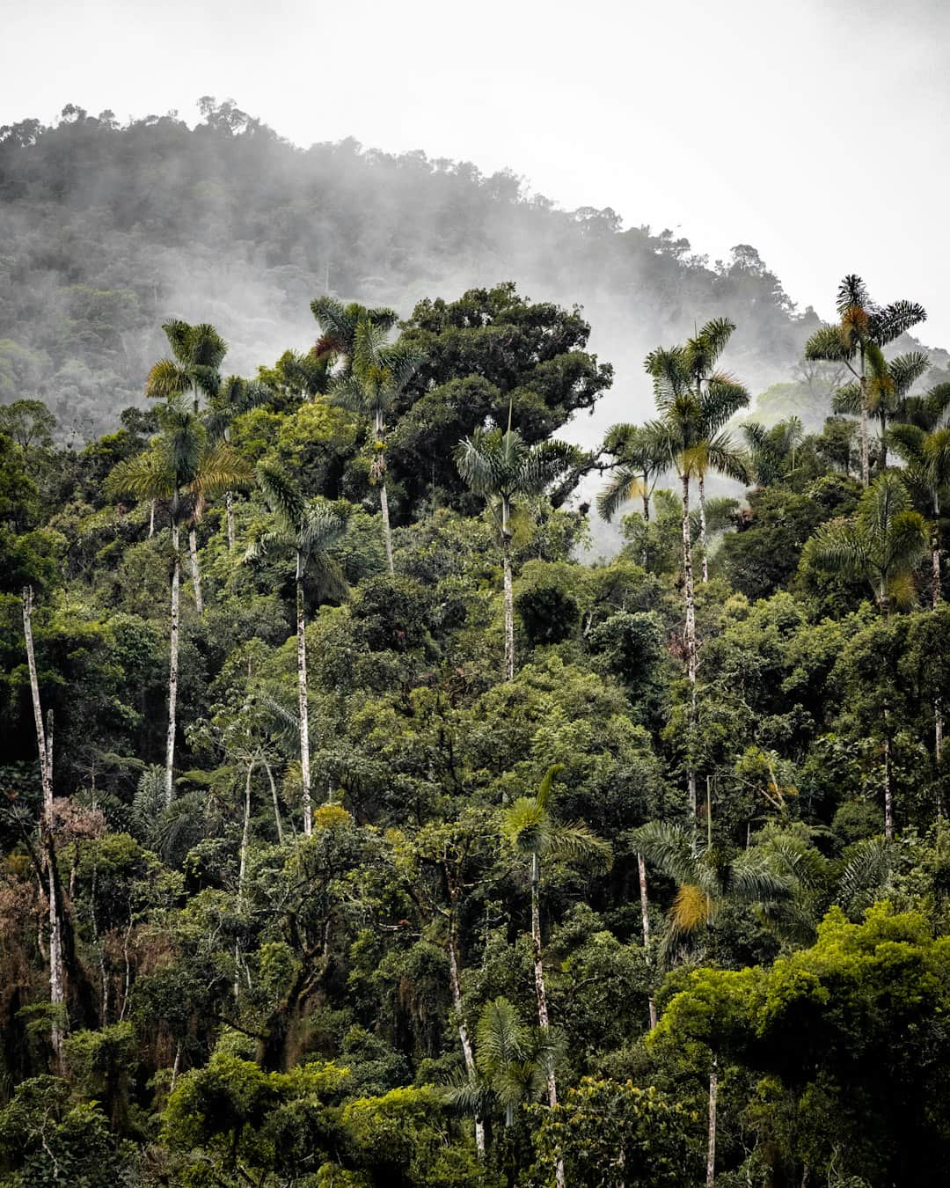





Case Study: GIS in Action
Amazon Rainforest Monitoring
GIS technology tracks deforestation rates in the Amazon, revealing alarming trends.
Satellite Imagery Utilization
High-resolution satellite images provide critical data for forest health assessments.
Illegal Logging Detection
GIS identifies illegal logging activities, enabling targeted enforcement actions.
Rapid Response Mechanisms
Real-time data allows for swift governmental responses to environmental threats.
Policy Adjustments Enabled
Data-driven insights lead to effective policy changes for forest conservation.
Photo by Renting C

Slide 8


Traditional Methods vs GIS Methods in Forest Monitoring
Traditional Methods
GIS Methods
Rely heavily on field surveys for data collection.
Utilize spatial data for comprehensive analysis.
Time-consuming and labor-intensive processes.
Faster data processing and analysis capabilities.
Limited spatial analysis capabilities.
Higher accuracy in mapping and monitoring changes.
Higher potential for human error in data collection.
Cost-effective for long-term monitoring and management.
Costly in terms of manpower and resources for long-term monitoring.
Facilitates integration of various data sources for better decision-making.

Slide 9




Visual Impact of GIS Data
This slide showcases GIS data visualizations that highlight forest health, biodiversity, and deforestation trends. Key takeaways include the importance of spatial analysis in forest management and conservation efforts.

Slide 10
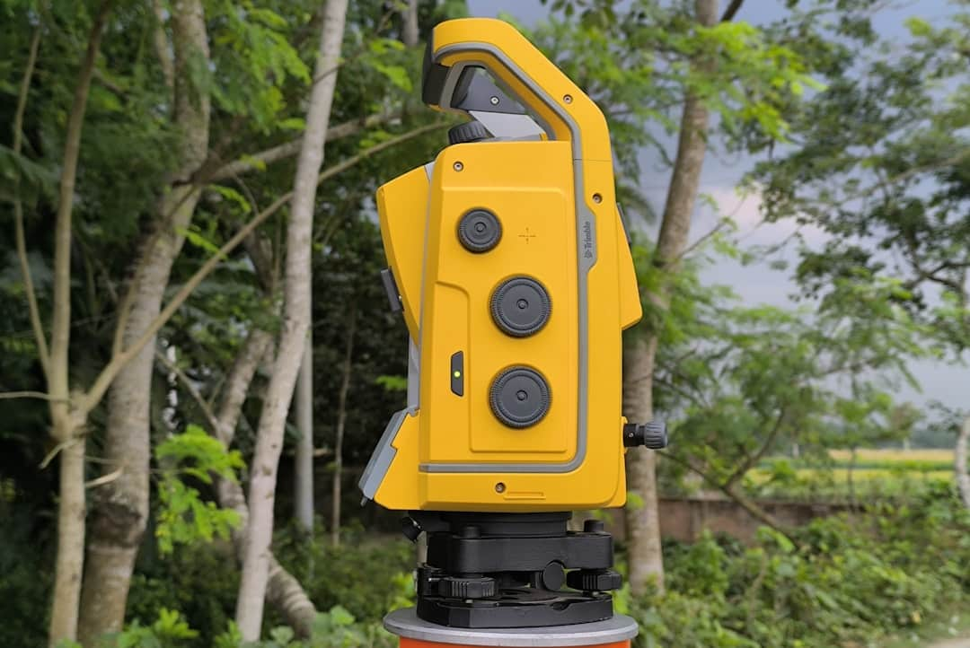



Challenges in GIS Application
Data Accuracy Issues
High Costs of Implementation
Inaccurate data can lead to flawed forest management decisions and ineffective monitoring.
Initial setup and maintenance costs can exceed $100,000 for comprehensive GIS systems.
Integration Difficulties
GIS must seamlessly integrate with existing forest management systems for effective use.
Photo by Nasim Uddin

Slide 11
How to Integrate GIS Effectively in Forest Monitoring
1
Identify Objectives for Monitoring
Define clear goals for what you want to achieve with GIS in forest monitoring, such as tracking deforestation, assessing biodiversity, or managing resources.
2
Collect and Prepare Spatial Data
Gather relevant spatial data from various sources, including satellite imagery, topographic maps, and field surveys, and ensure it is formatted for GIS analysis.
3
Analyze Data Using GIS Software
Utilize GIS software tools to analyze the collected data, applying spatial analysis techniques to derive insights and visualize patterns in forest conditions.
4
Implement Findings into Forest Management
Translate the insights gained from GIS analysis into actionable strategies for forest management, ensuring that decisions are data-driven and effective.

Slide 12



Transformative Impact of GIS on Forest Management
30%
90%
75%
Reduction in Illegal Logging
Accuracy in Forest Health Assessments
Adoption Rate by Forest Agencies
Achieved through enhanced monitoring and enforcement
Utilizing advanced GIS technologies for precise evaluations
Reflecting the growing reliance on GIS for sustainable management

Slide 13





Conclusion
In summary, GIS technology significantly enhances forest monitoring by improving data accuracy, enabling real-time analysis, and facilitating better decision-making. Future steps should focus on integrating advanced analytics and community engagement to optimize forest management practices. By leveraging GIS, we can ensure sustainable forest ecosystems for generations to come.

